Slide 1

Introduction To Machine Learning Algorithms
#DataDawgs Presentation by Jonathan Waring

Slide 2
Kaggle Data Science bowl
We are looking for interested members who would like to participate in Kaggle’s 2018 Data Science Bowl
The contest is being sponsored by Booz Allen Hamiliton and there are cash prizes available to the top 5 placing teams (submission deadline: April 9th)
The competition is to create an algorithm to automate nucleus detection, which could help unlock cures for disease more quickly
Teams will create a computer model that can identify a range of nuclei across varied conditions

Slide 3
Machine Learning Algorithms
Representation: language for patterns/models, expressive power
Evaluation: scoring methods for deciding what is a good fit of model to data
Beware of overfitting → your model may be “too good” with your training data, but may not generalize well during testing
Search: method for enumerating patterns/models
Optimization techniques → most commonly used optimizer is gradient descent, which iteratively searches for the minimization of some error function (will not go into detail of how this works today)

Slide 4
Association Rule Learning
Association rule learning is a rule-based machine learning method for discovering interesting relations between variables in large databases
Such information can be used as the basis for decisions about marketing activities, Web usage mining, intrusion detection, continuous production, and bioinformatics

Slide 5
Association Rule Learning
The problem of association rule mining is:
Let I = {i₁, i₂, …, i_{n}} be a set of n attributes called items
Let D = {t₁, t₂, …, t_{m}} be a set of transactions called the database
Each transaction D has a unique transaction ID and contains a subset of the items in I
A rule is defined as an implication of the form: If X then Y where X and Y are subsets of I
Every rule is composed by two different sets of items, also known as itemsets, X and Y, where X is called antecedent or left-hand-side (LHS) and Y consequent or right-hand-side (RHS).
Example association rule: If A and not B, then C

Slide 6
Support and confidence
Support is defined as the minimum percentage of transactions in the DB containing A and B.
Confidence is defined as the minimum percentage of those transactions containing A that also contain B.
Ex. Suppose the DB contains 1 million transactions and that 10,000 of those transactions contain both A and B.
We can then say that the support of the association if A then B is:
S= 10,000/1,000,000 = 1%.
Likewise, if 50,000 of the transactions contain A and 10,000 out of those 50,000 also contain B then the association rule if A then B has a confidence 10,000/50,000 = 20%.
Confidence is just the conditional probability of B given A.

Slide 7
Association Rule Algorithms
Association rule algorithms typically employ some sort of method to efficiently find rules that exceed a pre-defined support or confidence level
They do so by finding all itemsets with the given minimum support and generating rules from them!
Let’s look at an example on the next slide

Slide 8
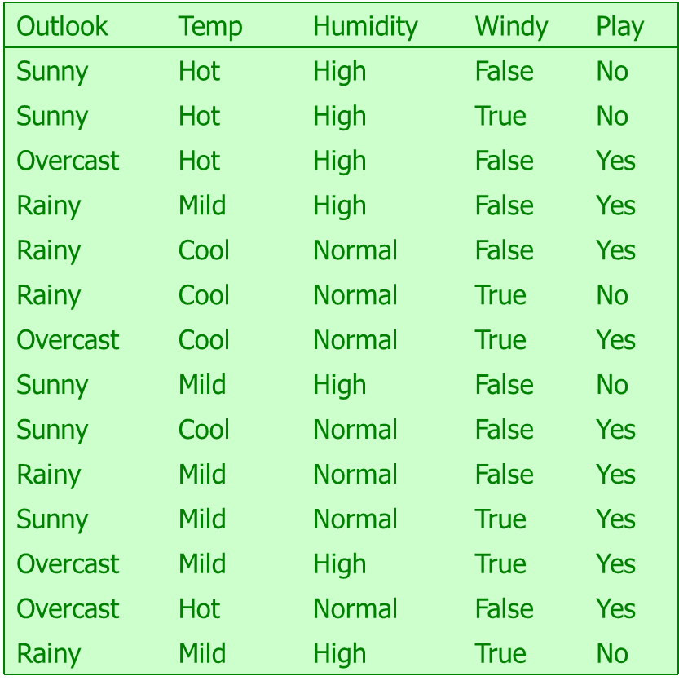
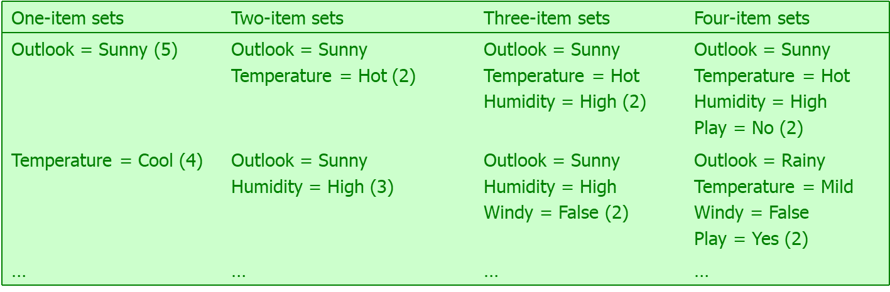
Weather Data
Total number of item sets with a minimum support of at least two instances: 12 one-item sets, 47 two-item sets, 39 three-item sets, 6 four-item sets and 0 five-item sets

Slide 9
Generating Rules from ItemSet
Once all item sets with the required minimum support have been generated, we can turn them into rules
Example 4-item set with a support of 4 instances:
Seven (2^{N}-1) potential rules:
Humidity = Normal, Windy = False, Play = Yes (4)
If Humidity = Normal and Windy = False then Play = Yes
If Humidity = Normal and Play = Yes then Windy = False
If Windy = False and Play = Yes then Humidity = Normal
If Humidity = Normal then Windy = False and Play = Yes
If Windy = False then Humidity = Normal and Play = Yes
If Play = Yes then Humidity = Normal and Windy = False
If True then Humidity = Normal and Windy = False and Play = Yes
4/4
4/6
4/6
4/7
4/8
4/9
4/12

Slide 10
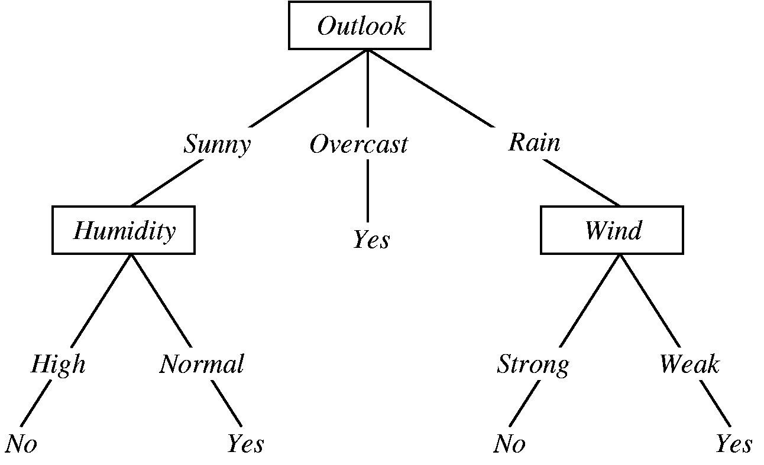
Decision Tree Classification
A decision tree uses a tree structure to represent a number of possible decision paths and an outcome for each path
Decision trees are very easy to understand and interpret, and also has the advantage of handling both numeric and categorical attributes (which isn’t true for other algorithms will discuss)

Slide 11
Constructing a Decision Tree
Strategy: top down learning using recursive divide-and-conquer process
First: select attribute for root node Create branch for each possible attribute value
Then: split instances into subsets One for each branch extending from the node
Finally: repeat recursively for each branch, using only instances that reach the branch
Stop if all instances have the same class

Slide 12
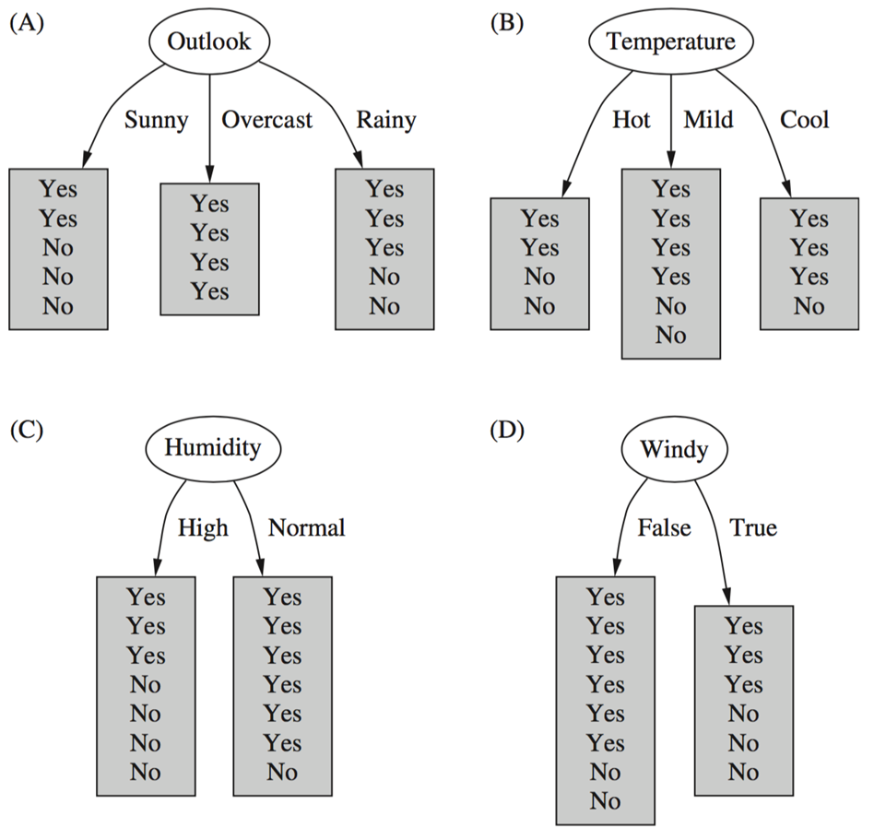

Which attribute to select?

Slide 13
Criteria for attribute selection
Which is the best attribute?
Want to get the smallest tree
Heuristic: choose the attribute that produces the “purest” nodes
Popular selection criterion: information gain
Information gain increases with the average purity of the subsets
Strategy: amongst attributes available for splitting, choose attribute that gives greatest information gain
Information gain requires measure of impurity
Impurity measure that it uses is the entropy of the class distribution, which is a measure from information theory

Slide 14
Computing Information
We have a probability distribution: the class distribution in a subset of instances
The expected information required to determine an outcome (i.e., class value), is the distribution’s entropy
Formula for computing the entropy:
Entropy is maximal when all classes are equally likely and minimal when one of the classes has probability 1

Slide 15
Computing information gain
Information gain: information before splitting – information after splitting
Information gain for attributes from weather data:
Gain(Outlook ) = Info([9,5]) – info([2,3],[4,0],[3,2])
= 0.940 – 0.693 = 0.247 bits
Gain(Outlook ) = 0.247 bits
Gain(Temperature ) = 0.029 bits
Gain(Humidity ) = 0.152 bits
Gain(Windy ) = 0.048 bits

Slide 16
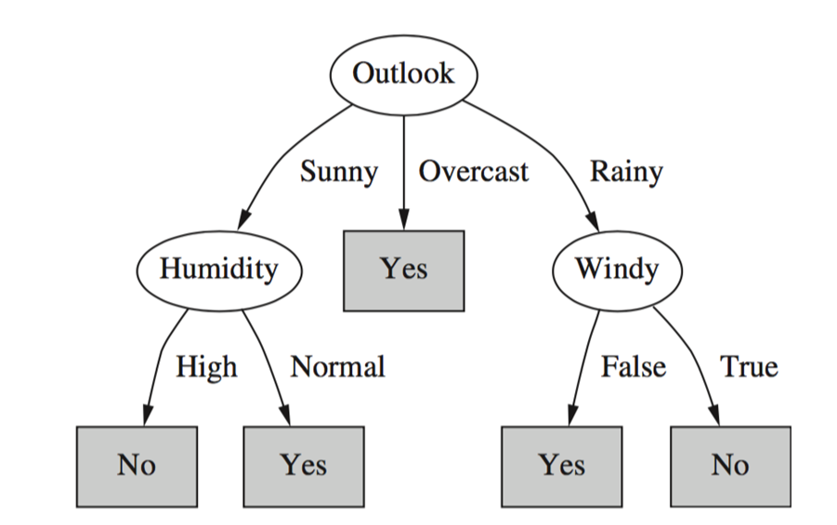
Final decision Tree
Note: not all leaves need to be pure; sometimes identical instances have different classes
Splitting stops when data cannot be split any further

Slide 17
Random Forest Trees
Decision trees often can overfit the training data using the algorithm we just discussed
Most decision tree algorithms today use a slightly different measure of node purity that attempts to combat this (it is known as the gain ratio for those wanting to look it up)
However, random forests is another algorithm that does well at handling this problem
It works by building multiple decision trees and lets each tree vote on how to classify inputs
The final decision is made by the majority vote
Again, we will not go into too much detail of this algorithm today, but it is something to know

Slide 18
Naïve bayes classification
Naïve Bayes classifiers are a family of simple probabilistic classifiers based on applying Bayes' theorem with strong (naive) independence assumptions between the features
Independence assumption is almost never correct! But this scheme often works surprisingly well in practice
Baye’s rule is stated as probability of an event, H, given evidence, E:
P(H | E) = P(E | H)P(H) / P(E) (we usually drop the P(E) term)
A priori probability of H : P(H)
Probability of event before evidence is seen
A posteriori probability of H : P(H | E)
Probability of event after evidence is seen
Likelihood of H : P(E | H)

Slide 19
Naïve Bayes Classificatoin
Classification learning: what is the probability of the class given an instance?
Evidence E = instance’s non-class attribute values
Event H = class value of instance
Naïve assumption: evidence splits into parts (i.e., attributes) that are conditionally independent
This means, given n attributes, we can write Bayes’ rule using a product of per-attribute probabilities:

Slide 20
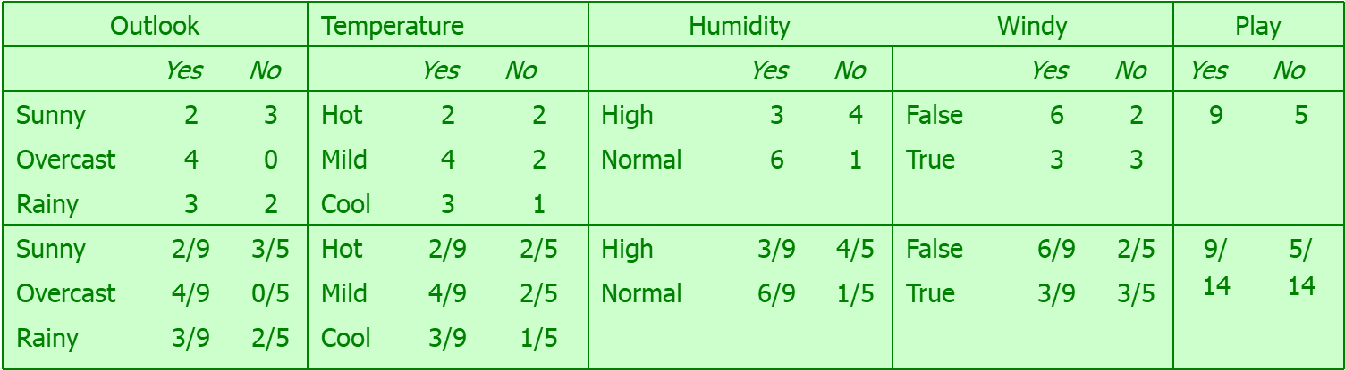
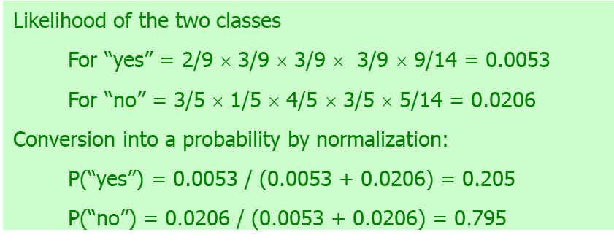
Probabilities for Weather Data
Outlook
Temp.
Humidity
Windy
Play
Sunny
Cool
High
True
?
Prediction of a new day

Slide 21
Zero-Frequency Problem
What if an attribute value does not occur with every class value? (e.g., “Humidity = high” for class “yes”)
Probability will be zero:
A posteriori probability will also be zero: (Regardless of how likely the other values are!)
Remedy: add 1 to the count for every attribute value-class combination (Laplace estimator)
Result: probabilities will never be zero
Note: Naïve Bayes can handle numeric attributes using Gaussian probability distribution estimates, but we will not cover that today

Slide 22
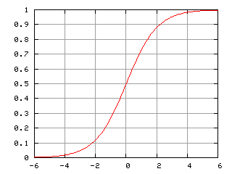
Logistic Regression for Classification
Logistic regression is a mathematical model used in statistics to estimate (guess) the probability of an event occurring having been given some previous data
Logistic Regression works with binary data, where either the event happens (1) or the event does not happen (0). So given some feature x it tries to find out whether some event y happens or not.
Logistic Regression uses the logistic function to find a model that fits with the data points. The function gives an 'S' shaped curve to model the data.

Slide 23
Odds
Logistic regression uses the concept of odds ratios to calculate the probability. This is defined as the ratio of the odds of an event happening to its not happening.
For example, the probability of a sports team to win a certain match might be 0.75.
The probability for that team to lose would be 1 – 0.75 = 0.25.
The odds for that team winning would be 0.75/0.25 = 3. This can be said as the odds of the team winning are 3 to 1
The odds can be defined as:
Odds = P(y = 1 | x) / 1 - P(y = 1| x)

Slide 24
Logit Transformation
The natural logarithm of the odds ratio is then taken in order to create the logistic equation. The new equation is know as the logit:
Logit(P(x)) = ln(P(y = 1 | x) / 1 - P(y = 1| x))
In Logistic regression the Logit of the probability is said to be linear with respect to x, so the logit becomes:
Logit(P(x)) = a + bx
Using the two equations together then gives the following:
P(y = 1 | x) / 1 - P(y = 1| x) = e^{a + bx}
This then leads to the probability:
P(Y = 1 | x) = e^{a + bx} / 1 + e^{a + bx} = 1 / 1 + e^{-(a + bx)}

Slide 25
K-nn
K-nearest neighbors algorithm (k-NN) is a non-parametric method used for classification and regression
In both cases, the input consists of the k closest training examples in the feature space. The output depends on whether k-NN is used for classification or regression:
In k-NN classification, the output is a class membership. An object is classified by a majority vote of its neighbors, with the object being assigned to the class most common among its k nearest neighbors (k is a positive integer, typically small). If k = 1, then the object is simply assigned to the class of that single nearest neighbor.
In k-NN regression, the output is the property value for the object. This value is the average of the values of its k nearest neighbors.

Slide 26
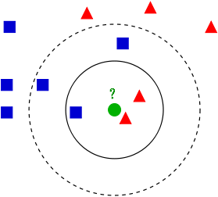
K-nn example
Example of k-NN classification:
The test sample (green circle) should be classified either to the first class of blue squares or to the second class of red triangles.
If k = 3 (solid line circle) it is assigned to the second class because there are 2 triangles and only 1 square inside the inner circle.
If k = 5 (dashed line circle) it is assigned to the first class (3 squares vs. 2 triangles inside the outer circle).

Slide 27
Linear Regression
Linear regression is a special case of regression analysis, which tries to explain the relationship between a dependent variable and one or more explanatory variables
Linear regression assumes that the output variable, Y, can be expressed as a linear combination of its input variables, X
Y = b₀ + b₁x₁ + … + b_{n}x_{n}
Each input variable is given a “weight” in determining how important it is to the prediction (be careful, this is not always a correct interpretation)

Slide 28
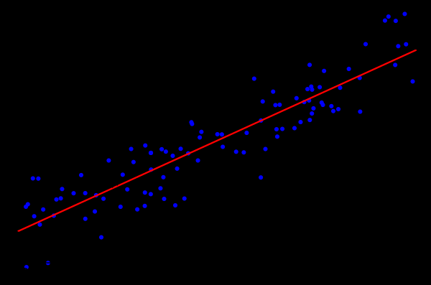
Linear regression picture
The idea is to find the red curve, the blue points are actual samples.
With linear regression all points can be connected using a single, straight line.
This example uses simple linear regression, where the square of the distance between the red line and each sample point is minimized.

Slide 29
K-means
K-means is a clustering algorithm that aims to partition n observations into k clusters in which each observation belongs to the cluster with the nearest mean, serving as a prototype of the cluster (this prototype is called the centroid).
This is the most commonly used unsupervised machine learning method
It is hard to determine what to make k be, but there have been methods used overtime to best choose (often guess and check)

Slide 30
The algorithm
To run a k-means algorithm, you have to randomly initialize k points to be centroids
Iteratively repeat the following until convergence:
Cluster assignment
Go through each of the data points and depending on which centroid is closer, it assigns the data points to one of the k cluster centroids.
Move centroids
Calculate the average of all the points in a cluster and moves the centroid to that average location.

Slide 31
Sklearn Tutorial
Now we will look at using some of these machine learning algorithms using Python and the Sklearn library

Slide 32
References
Some material was taken from Dr. Rasheed’s CSCI 4380 lecture material

